Slide 1
transforms

Slide 2
transform: translate(x, y)
🡹
translate(0,0)
🡹
translate(200px, 100px)

Slide 3
transform: rotate(x)
🡹
🡹
🡹
rotate(0deg)
rotate(45deg)
rotate(180deg)

Slide 4
transform: scale(x)
🡹
🡹
scale(1)
scale(2)

Slide 5
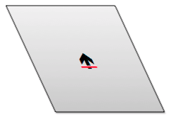
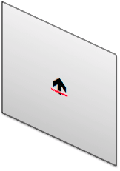
transform: skew(x, y)
🡹
skew(0deg, 0deg)
skewX(25deg)
skewY(25deg)

Slide 6
transform: skew(x, y)
🡹
25°
25°
skew(0deg, 0deg)
skewX(25deg)
skewY(25deg)

Slide 7
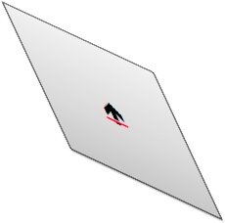
transform: skew(x, y)
🡹
skew(0deg, 0deg)
skew(25deg, 25deg)

Slide 8


Slide 9
transform: matrix(a,b,c,d,e,f)
🡹
???

Slide 10
transform: matrix(a,b,c,d,e,f)
a c e
b d f
0 0 1
matrix(a,b,c,d,e,f)
=
3x3 matrix

Slide 11
transform: matrix(a,b,c,d,e,f)
sx 0 0
0 sy 0
0 0 1
1 0 tx
0 1 ty
0 0 1
scale
translate
cos(a) -sin(a) 0
sin(a) cos(a) 0
0 0 1
1 tan(a) 0
tan(a) 1 0
0 0 1
rotate
skew

Slide 12

transform: matrix(a,b,c,d,e,f)
-1 0 0
0 1 0
0 0 1
1 0 0
0 -1 0
0 0 1
-1 0 0
0 -1 0
0 0 1
flip horizontal
flip vertical
flip both

Slide 13
Browser Support
-moz-transform: rotate(45deg); // FF3.5+
-webkit-transform: rotate(45deg); // Saf3.1+, Chrome
-o-transform: rotate(45deg); // Opera 10.5
-ms-transform: rotate(45deg); // IE9
transform: rotate(45deg);
filter: progid:DXImageTransform.Microsoft.Matrix(
M11=0.7071067811865476,
M12=-0.7071067811865476,
M21=0.7071067811865476,
M22=0.7071067811865476,
sizingMethod='auto expand'); // IE6 – IE9

Slide 14
3D Transformations

Slide 15
3D functions Examples
rotate3d
translate3d
skew3d
scale3d
matrix3d
http://www.keithclark.co.uk/labs/css-fps/old/
http://demo.marcofolio.net/3d_animation_css3/
https://www.clicktorelease.com/code/css3dclouds/

